Slide 1
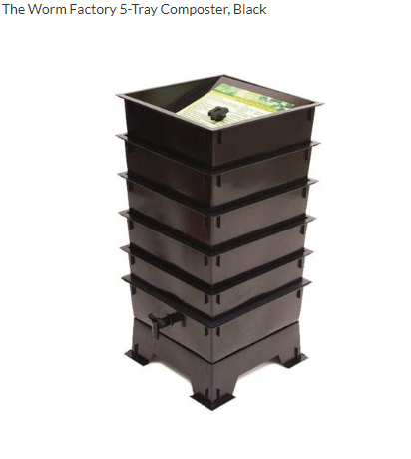
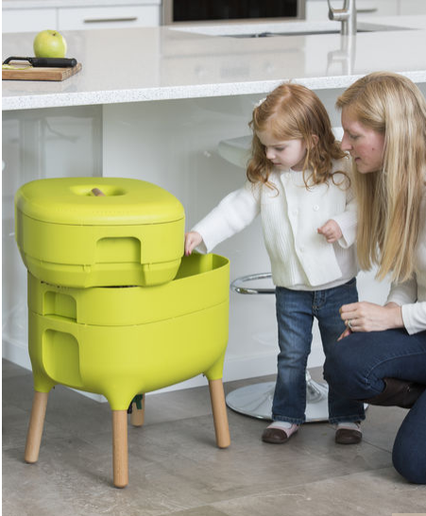
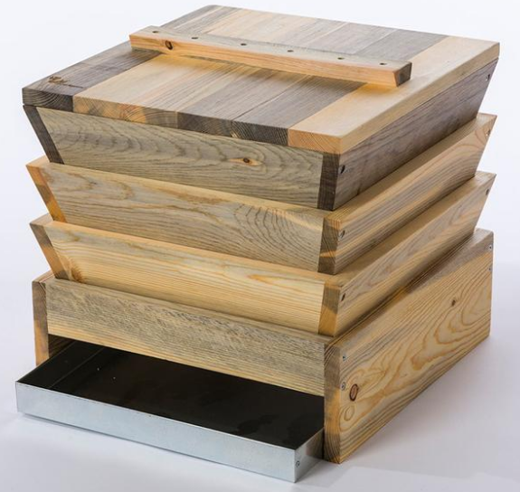
Vermicomposting (Red Wigglers)
Composts may smell sometimes but sometimes so do you.
(With proper maintenance you will be fine)
Notes:
Vermicomposting: composting using various species of worms, usually red wrigglers and other earth worms.
Generally the composting is done indoors with red wigglers … but you may also introduce your red wigglers into your outdoor compost; however, they are finicky outside and not cold hard.
I say this disclaimer because routine maintenance is needed. And we all make mistakes and at some point you will probably make a mistake and that’s okay. I have made plenty of mistakes and have had a smelly compost before. Take this as a learning opportunity not as a ending point. This is because at some point your bin may get smelly and you may want to throw it all away. I strongly advice against this there is plenty of potential in that bin that you would throw out. Because if you have a smelly bin you most likely made a small mistake. most likely anaerobic (lacking oxygen) or is over saturated with nitrogen rich foods and water. Not only can this smell but this can attract unwanted bugs. This is okay because with proper action you can resolve this issue with an hour or a day at most. Routine maintenance is needed.

Slide 2
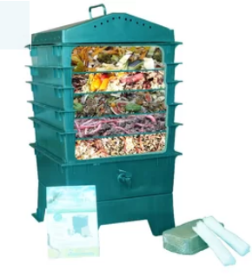
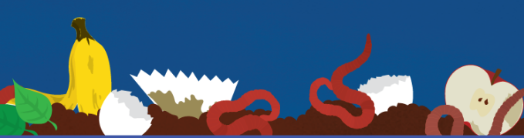
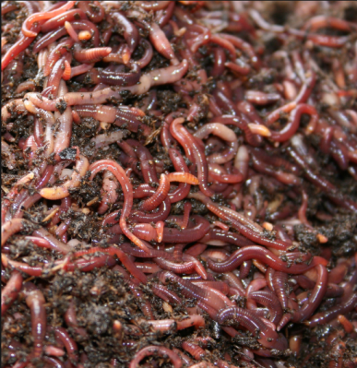
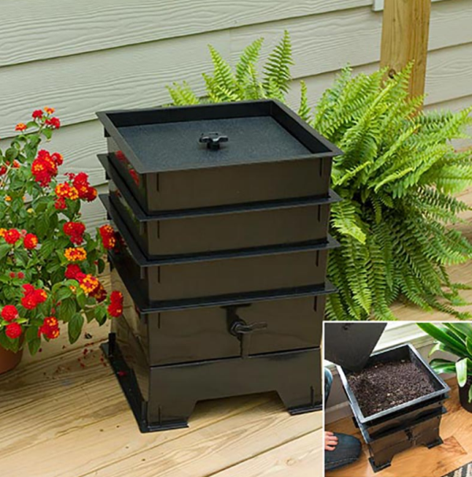
What is vermicomposting/ Red Wiggler?
What are the do’s and don'ts of Vermicomposting?
    Potential Vermicomposting bins
    Good food vs Bad Food
Red Wigglers facts
Troubleshooting

Slide 3
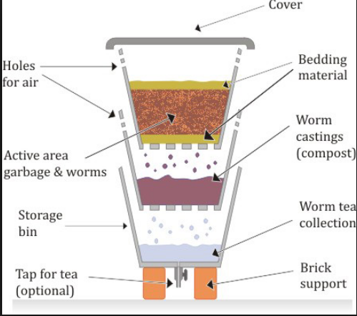
What is vermicomposting/ Red Wigglers?
Vermicomposting is composting indoors with worms: (normally red wigglers)
Red Wigglers Eisenia Fetia (a.k.a Compost worms or Trout Worms)
Range: surface level to 12”
Thrive in rotting vegetation,
compost, and manure.
Great to germinate plants with
Fertilizer or medium
Notes:
Vermicomposting is the use of earth worms, red wrigglers, and other worms to convert organic waste into fertilizer. While earth worms are mainly used for aerating your soil or compost by eating your soil and tunneling deep into soil or compost then are not best suited for compost due to the fact they prefer cooler soils. Red Wigglers (a.k.a. compost or trout worms) are experts in breaking down organic waste into usable compost within just a few days or even weeks and tend to only dwell in the top layer of decaying matter about 6” deep and generally go no further than 12” deep. They love warm soils where they can clump together and eviscerate all decaying matter around them. Not only can red wigglers break down your organic waste but they are great bait for trout, snacks for your fish, reptiles or birds at home.
Fetida or Foetida Latin term used for foul-smelling species
Consume 90 percent of what you give them and that includes newsprint, plain cardboard, egg shells, daffodil leaves, spent flowers, vegetable leftovers, coffee grounds and animal fur

Slide 4
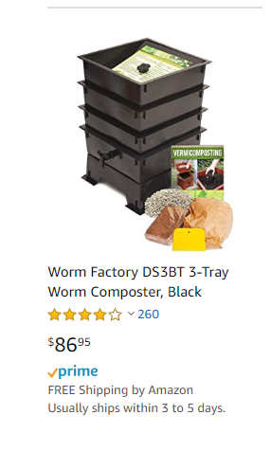
Potential Composting Sites
ANYWHERE!
Don't be afraid to fail .Be prepared to fail
Size, shape, and location are based off what is acceptable and suitable for your lifestyle
Best when used in Vermicomposting bin

Slide 5
What to feed your worms
Good Foods: Bananas, Pumpkins, Apples, Cucumbers, Tomatoes, Corn, Strawberries, Celery, Carrots, Cherries, Teabags & more
Don’t forget your Carbon ideal carbon is about 2.5-1 for worms ( I found 3-1 works better)
Bad Foods: Plastic, Dairy, Salted or Spiced foods, Grease, Fats, Meats, bones, Onion, Garlic, & Citrus Fruits with high acidity

Slide 6
Fact Sheet
Life span: about a year
No eyes; however, cells that can detect light
No teeth; grind food using grit (Gizzard)
No lungs; skin (Moist environment)
Can eat ½ their body weight in food
Hermaphrodite; still need a partner
Reproduction starts at 2 months of age
Mature adult can produce 100 worms/ year
Coelomic Lucid; yellow secretion
5 “heart-like” organs (aortic arches)
Notes:
http://www.tilthalliance.org/learn/resources-1/compost/red-wriggler-tip-sheet

Slide 7
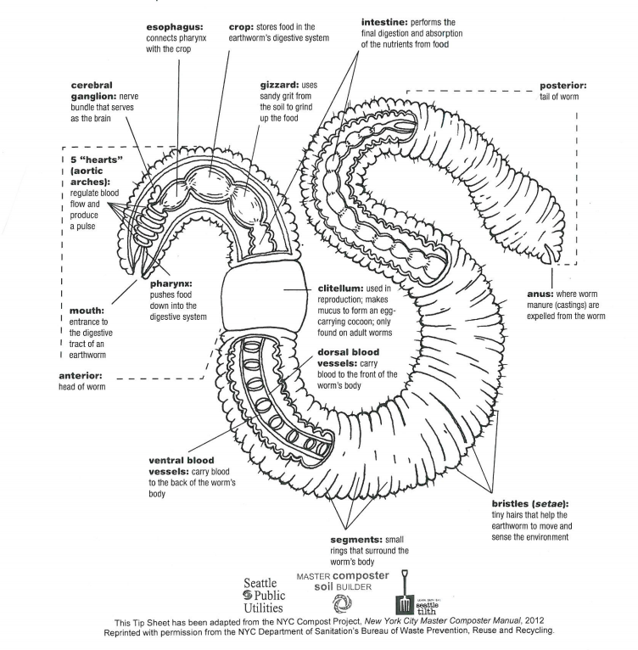
Anatomy of a Worm

Slide 8
Troubleshooting:
Don’t kill the messenger
Other critters can/will move into your bins, too. Sow bugs or pill bugs will be the first to arrive, and their manure is just as good as worm castings.
Other residents may included ants and some various flies.
Fruit Fly vs Fungus Gnats
When in doubt Google it out!

Slide 9
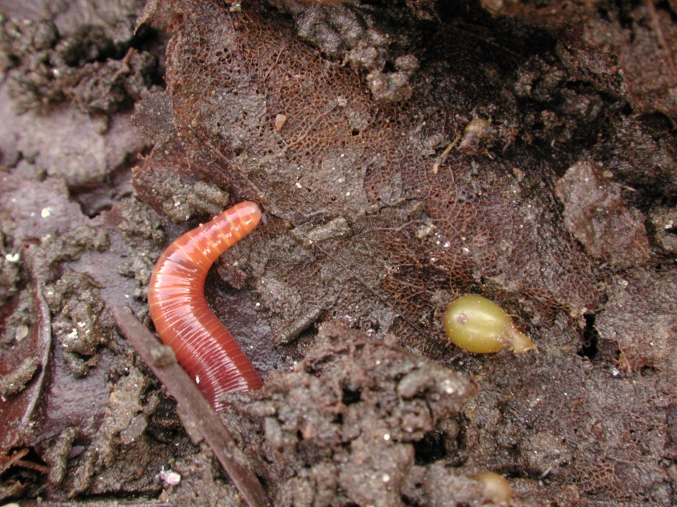
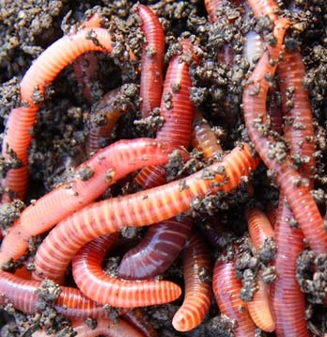
Colorful Pictures
Notes:
Cocoon incubation day is generally 23 days and will change from lemon color to an amber color where 4-6 worms will develop in an embryo

